Slide 1

Chandigarh University
Department of Mathematics
B.Tech. CSE (Core/DS/IT/CC)
Semester-3
Subject Code:25MTT-202
Discrete Mathematics
Unit - 4 (Chapter- 4.3.1)
Dr. SARTAJ
DISCOVER . LEARN . EMPOWER

Slide 2

CO mappings

Slide 3

CO-PO mappings
Note: Degree of relevance/correlation: 1-Low, 2-Medium, 3-High, Blank or ‘- ‘- Nil

Slide 4
Topics Overview
Hamiltonian graph
Conclusions
Video links
References

Slide 5
Hamilton paths and Graphs
Hamilton path: It is a path which visits every vertex in graph G exactly once.
Hamilton trail: It is a trail which visits every vertex in graph G exactly once.
Hamilton circuit: It is a circuit which visits every vertex in graph G exactly once.
Hamilton cycle: It is a cycle which visits every vertex in graph G exactly once.
Hamiltonian Graph: A connected graph is a Hamiltonian graph if it has a Hamiltonian cycle.

Slide 6
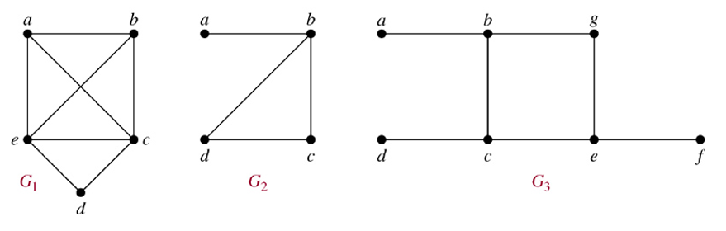
Hamilton paths and Graphs
Example: Which of these graphs has a Hamilton circuit? If not a Hamilton circuit, a Hamilton path?
G₁ has a Hamilton circuit: a, b, c, d, e, a
G₂ does not have a Hamilton circuit, but does have a Hamilton path: a, b, c, d
G₃ has neither.

Slide 7
Hamilton paths and Graphs
Note:
Unlike the Euler circuit problem, finding Hamilton circuits is hard.
There is no simple set of necessary and sufficient conditions, and no simple algorithm.

Slide 8
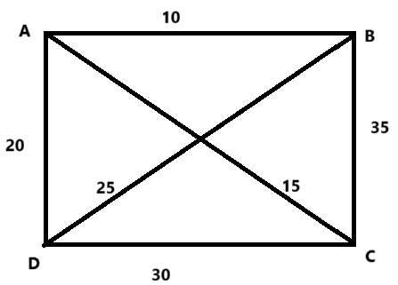
Hamilton paths and Graphs
Example: Imagine there are four cities (A, B, C, D) with the following distances:
A → B: 10, A → C: 15, A → D: 20, B → C: 35, B → D: 25, C → D: 30. Find the shortest route to visit all cities once and return to the starting point.
Solution: All Possible Tours with distances are:
1. A → B → C → D → A: 95
2. A → B → D → C → A: 80
3. A → C → B → D → A: 95
4. A → C → D → B → A: 80
5. A → D → B → C → A: 95
A → D → C → B → A: 95

Slide 9
Hamilton paths and Graphs
Note: 2nd and 4th are the shortest routes.
Basically, here we have shortlisted the Hamiltonian cycles.

Slide 10
Hamilton paths and Graphs
Applications of Hamiltonian Graphs
Traveling Salesman Problem (TSP): Used in logistics and delivery route optimization to visit all locations exactly once and return.
Network Design: Ensures efficient communication paths and fault tolerance in computer networks.
Genome Sequencing: Helps in DNA assembly by finding sequences that cover all fragments exactly once.
Tourist Route Planning: Optimizes sightseeing itineraries to avoid revisiting locations.
Gaming and Puzzle Solving: Basis for games and puzzles, like the "Knight’s Tour" in chess.

Slide 11
Hamilton paths and Graphs
Summary

Slide 12
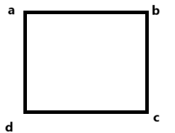
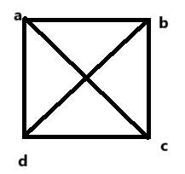
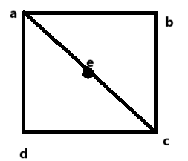
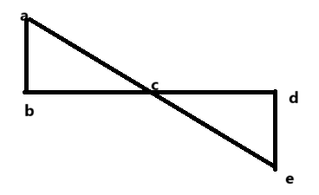
Acticity-1
Questions: Identify the Euler and Hamiltonian graphs amongst the following?

Slide 13
Exit Ticket
“How to decide where to use Euler and Hamiltonian graphs”

Slide 14
Conclusion
Hamiltonian graph and related applications are discussed.
Related examples are given.
ns

Slide 15
Video Links
https://youtu.be/HvFyVSSwF14?si=mz0BnrlIgPhxlT3t
https://youtu.be/H8aPbP86WyE?si=J3iZlys16PdHvUWY (Video Links)
https://drive.google.com/file/d/1zm_o2dthNGIi-OXsgP8McUz4SUlb9q3p/view?usp=sharing
(Book Link)

Slide 16
References
Sr. No. | Author | Name of the Book | Publisher | Year of Publication
1 | Kenneth H. Rosen | Discrete Mathematics and Its Applications | McGraw-Hill | 2019
2 | C. L. Liu | Elements of Discrete Mathematics | McGraw-Hill | 1996
3 | J. P. Tremblay, R. Manohar | Discrete Mathematical Structures with Applications to Computer Science | Tata McGraw Hill | 2001
4 | Kolman, Busby, Ross | Discrete Mathematical Structures | PHI | 2001
5 | Narsingh Deo | Graph Theory with Applications to Engineering and | PHI | 2017

Slide 17
Thanks!!!

